Slide 1
The Occupational Alliance for Risk Science (OARS)
Organizing Initiative for the Workplace Environmental Exposure Levels (WEELs)
February 25, 2020
Andy Maier (andrew.maier@cardno.com)

Slide 2
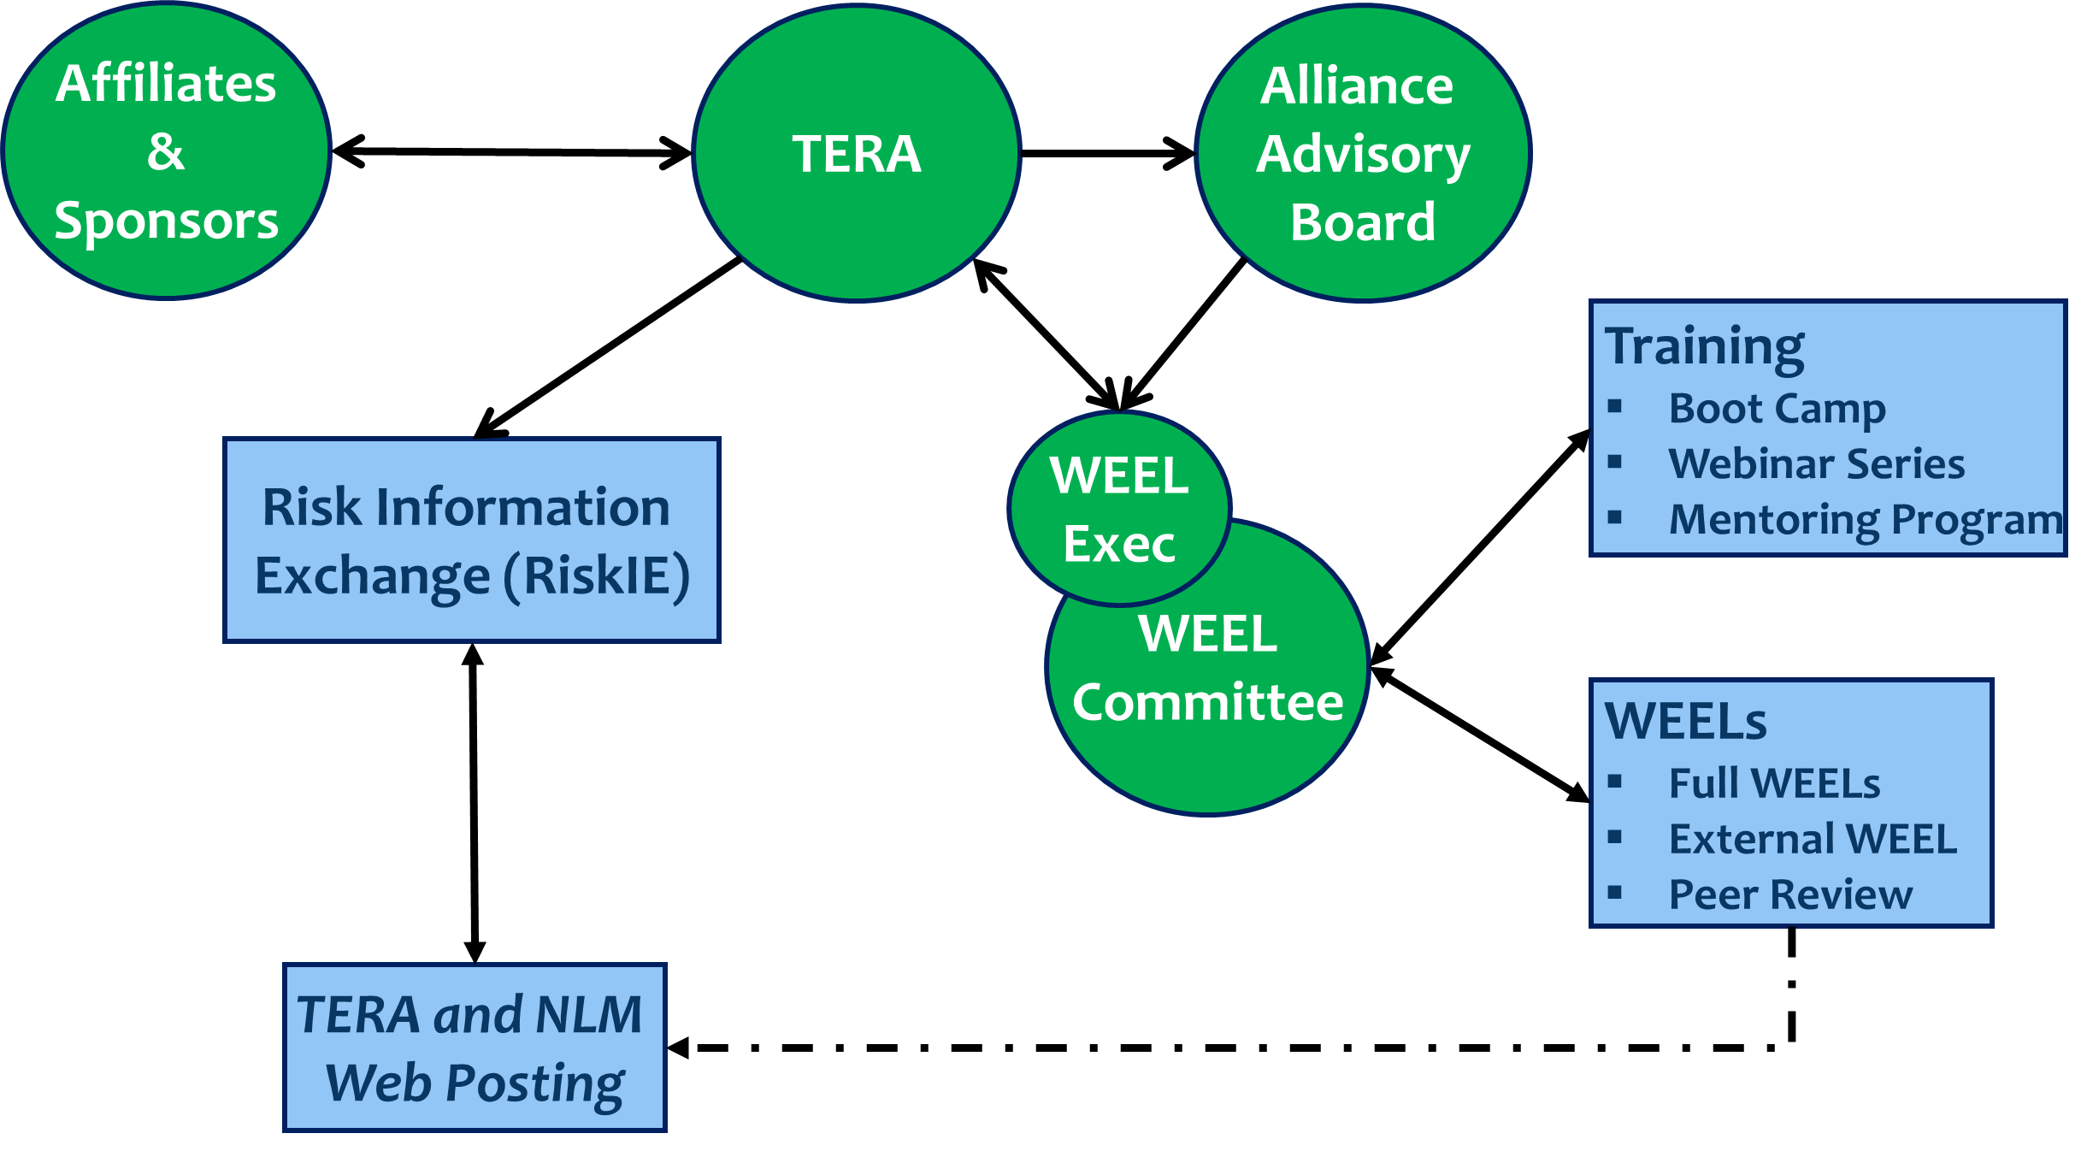
Why OARS?
Harmonization of Occupational Exposure Limits (OELs) and Derivation Science
Increased OEL resources
Managed stakeholder engagement
Education on OELs

Slide 3
Do We Need OEL Coordination?
Workers recognized a potential population at increased risk due to exposure potential.
OELs are central for worker health protection.
Many chemicals and not enough OELs.
Use of different sources of information complex.

Slide 4
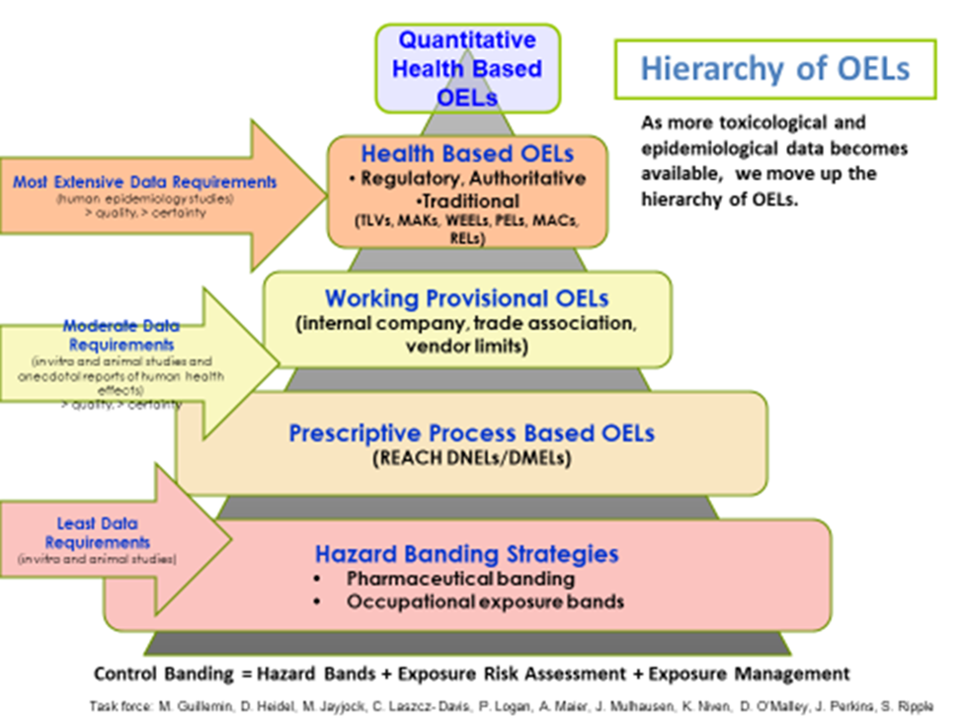

Slide 5
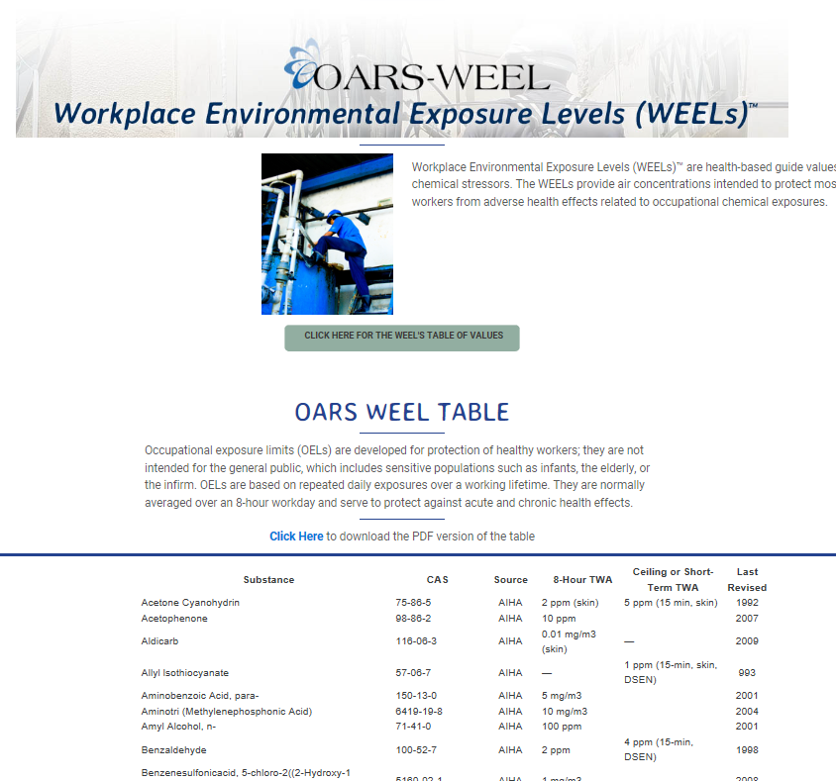
What are WEELs?
Workplace Environmental Exposure Levels (WEELs) are health-based guide values for chemical stressors.
Provides air concentrations intended to protect most workers from adverse health effects related to occupational chemical exposures.
Derived as 8-hour time weighted average (TWA) concentrations, short-term exposure limits (STEL), or ceiling limits.
Hazard Notations for skin absorption and sensitization.
https://www.tera.org/OAR

Slide 6
History of the WEELs
WEEL Committee was established in 1976 by the American Industrial Hygiene Association (AIHA) Guideline Foundation.
WEELs available for purchase in booklet form and full documentation sets from AIHA.
AIHA board votes to discontinue new WEEL development in August 2011.
AIHA Board votes to transfer WEELs to TERA in January 2012.
The Occupational Alliance for Risk Science (OARS) is established in January 2012.
January 2017 began publishing full dossiers in Toxicology and Industrial Health.
As of 2020 WEELs established for 176 substances.

Slide 7
WEEL Committee
A volunteer technical expert committee.
Approximately 30 members.
Diverse organizational affiliations.
Occupational health professions
toxicologists,
industrial hygienists,
risk assessors.
Operates as an expert panel with substance author team drafts approved by full committee review and external comment.

Slide 8
Impact Assessment
Cited in EPA (TSCA) and FDA (PMTA) guidance.
Cited in OSHA guidance on chemicals with no PELs.
WEELs used in emergency response applications (DoE PACs).
WEELs used as part of NIOSH OEB validation effort.
Accepted as peer reviewed values in ASHRAE/ISO-817.
Accepted as authoritative OELs by SafeWork Australia.
NASA Standard 1800.1D Chapter 4.
Cited on many SDSs.

Slide 9
WEELs – What is Different?
Same health-based expert committee approach as other organizations, but effort to….
Increase access to full OEL documentation for free,
Address under-served chemistries,
Provide education via professional societies,
Enable managed stakeholder engagement.

Slide 10
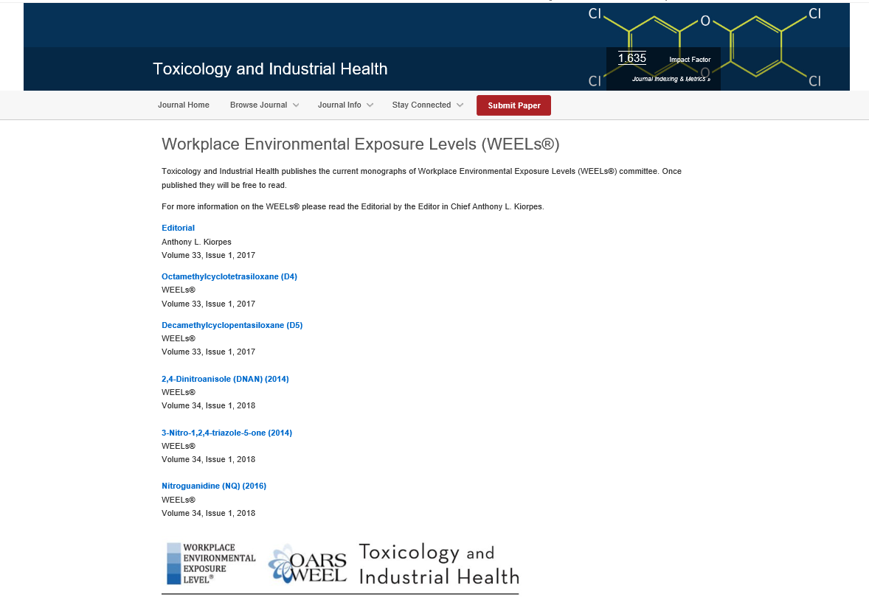

Slide 11
OEL Science
WEELs develop(ing) procedural documents to increase transparency in methodology building from current best practices
Cancer risk assessment (MoA focused - D4 and D5 siloxanes).
Dose-response (BMD use – Picolines).
Sensitization evaluation and notation (WoE – Limonene).
Inhalation Dosimetry and Dose Scaling (PBPK – NMP).
Read across and Data Gap Filling (common metabolite – Chlorosilanes).
And more…..

Slide 12
Key Reference
Journal of Occupational and Environmental Hygiene Volume 12, 2015 – Issue Supplement 1: State of the Science of Occupational Exposure Limit Methods and Guidance.
Review of current methods and resources
Point of departure estimation
Uncertainty factor application
Dosimetry adjustments
Use of new high throughput data and biomarkers
Aggregate and cumulative risks
Setting OELs for allergens
OEL selection

Slide 13
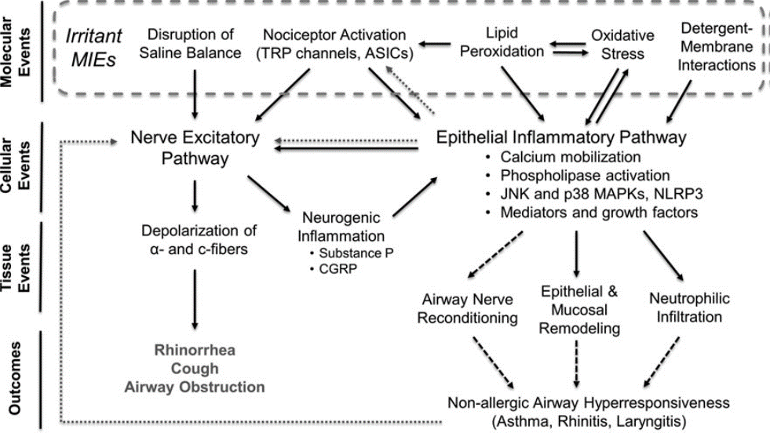
OEL Challenge - Route
Issue:
Route extrapolation is common
Most new chemicals lack inhalation route data
In most cases ADME and MoA data lacking
Question:
How do we have confidence the OEL will protect from respiratory tract effects?

Slide 14
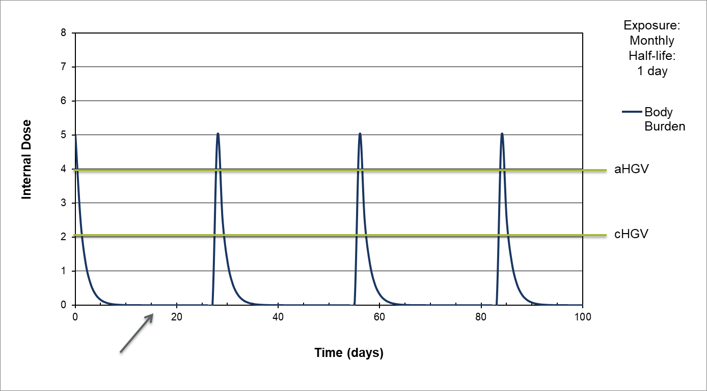
OEL Challenge - Temporal
Issue:
Most OELs set as “full-shift” TWA and STEL (or ceiling)
Most exposures are task based and intermittent
Many chemicals lack ADME and MoA data
Question:
How do we assess risk for “actual” exposure conditions when the OEL does not match the scenario?
Adapted from Haber et al. 2016.

Slide 15
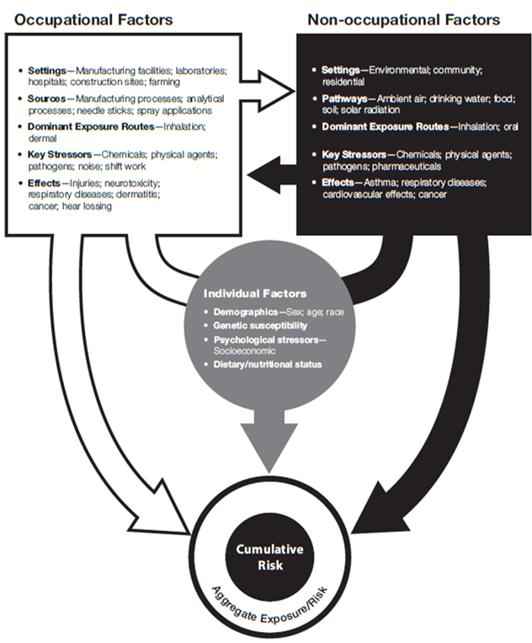
OEL Challenge - Cumulative
Issue:
OELs for Inhalation route only
Few dermal route limits
Few biological exposure limits
Relative source contribution not used
Question:
How do we set and apply total dose OELs – when biological monitoring not practical?
Lentz et al 2015

Slide 16
OEL Challenge – Residual Risk
Issue
“Traditional OELs” often higher than general population limits
Traditional OELs often higher than occupational benchmarks for chemical registrations (e.g., DNELs, ECELs)
Larger UFs increase confidence in protection for chemical of interest, but increase other risks
Question:
How do we balance risks with level of confidence in UF application?
Hanford DoE Site

Slide 17
Summary
Ongoing needs for harmonization in occupational risk sciences.
WEELs are important and unique resource.
WEELs are embracing evolving risk methods.
There are many challenges in both derivation AND application of OELs.

